Slide 1


SIMUTECH PROJECT REPORT ON
DISTILLATION COLUMN DESIGN
PROJECT MENTOR- SAMANVAY LAKHOTIA, RAJU SINGH
A presentation by AYUSH RAJ(200253) & MD SAIF(200577)

Slide 2
OBJECTIVE
To learn about Distillation process, its applications
Understanding the concepts of Raoult's Law and Vapour-liquid Equilibria
To understand what are Azeotropes and what are its separation methods
Based on the understanding, simulations of data for Vapour-liquid equilibria and azeotropic mixtures on software like Python/Matlab and Aspen
Understanding how to implement McCabe Thiele process and draw conclusions from it.

Slide 3

We would like to express my sincere gratitude to our Project Mentors Mr. Samanvay Lakhotia and Mr. Raju Singh for introducing us to the interesting concepts about distillation processes and also for his valuable support and advice in making this project possible.
I would also like to thank Shubh Maheshwari and Debanjan Dutta, the head of SimuTech, Chemineers Society who gave me this opportunity to be a part of this project.
ACKNOWLEDGEMENT

Slide 4
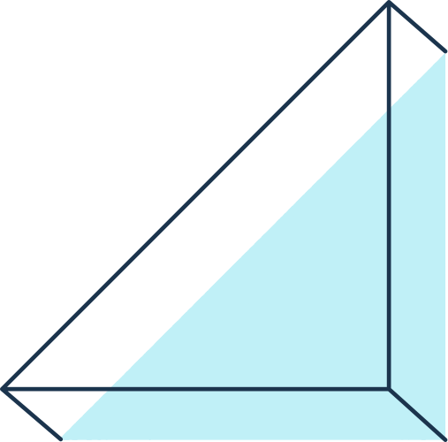
INTRODUCTION
WHAT IS DISTILLATION?
Distillation is a technique used to separate components of a mixture based on the difference in their relative volatility.
We can obtain very high purity product by the method of distillation.
VOLITILITY
Volatility is a measure of how readily a substance vaporizes or transitions from a liquid phase to a gas phase.
For eg. in binary VLE if substance A is more volatile than substance B then the mole fraction of A in gaseous phase will be more than the mole of B in gaseous phase.

Slide 5
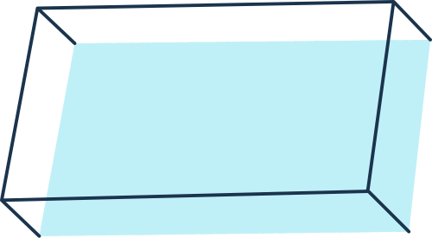
DIFFERENCE BETWEEN DSTILLATION AND EVAPORATION
DISTILLATION
EVAPORATION
Distillation is a technique used to separate components of a mixture based on the difference in their relative volatility.
It is a separation technique.
Conversion of liquid into vapour by using the heat is known as Evaporation.
Not a separation technique

Slide 6
VAPOUR-LIQUID EQUILIBRIA
GIBB'S PHASE RULE
If no. of components =C and such P phases exists and they are in equilibrium then the degree of freedom of the system can be calculated as follows:
D.O.F.=C-P+2
DEW POINT
The temperature at which a vapor begins or would begin to condense.
BUBBLE POINT
the temperature (at a given pressure) where the first bubble of vapor is formed.

Slide 7
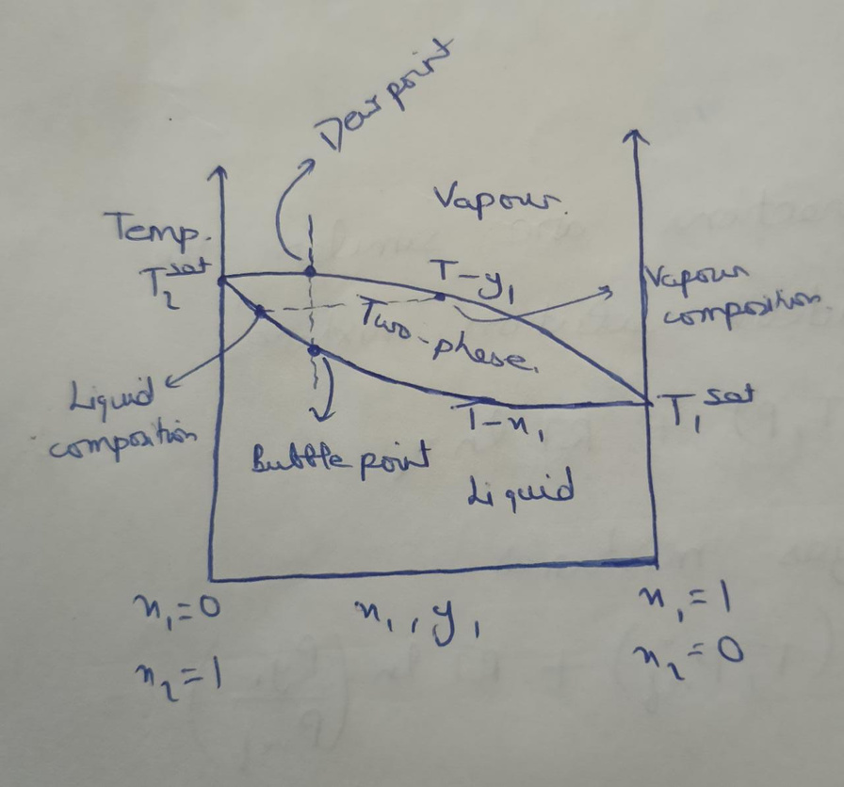
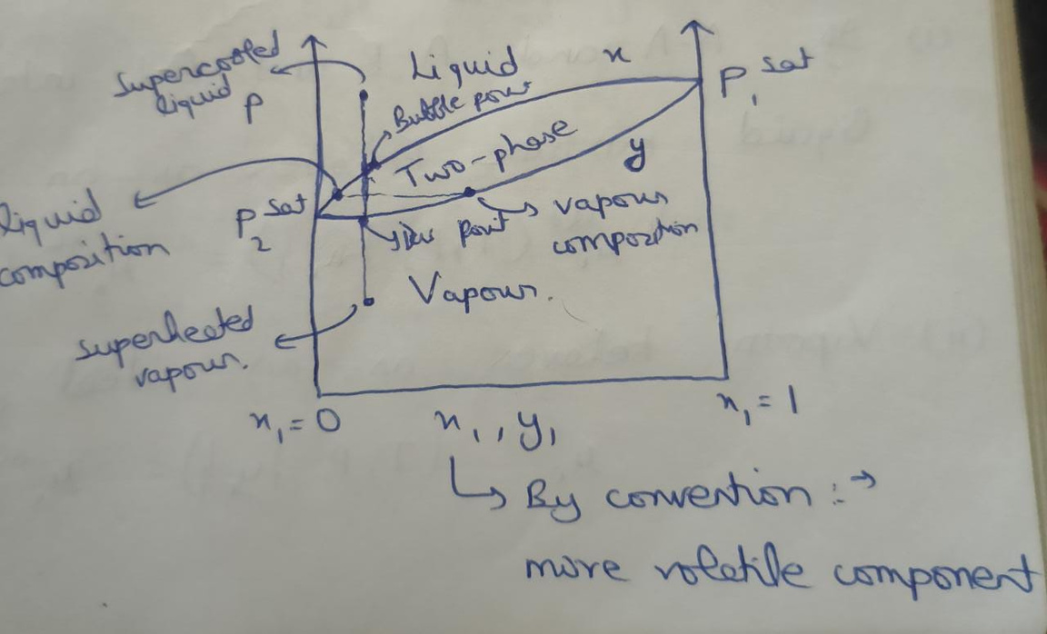
VLE
NOTE: We are only dealing with binary mixtures

Slide 8
RAOULT's LAW
For Ideal Systems:
y(i)*P=x(i)*Psat
where P is the Total pressure
y(i) is the mole component of 'i'th component in gaseous phase
x(i) is the mole fraction of 'i'th component in liquid phase
Psat is the Vapour Pressure of the pure component i at Temperature T
Antoine's Equation: To calculate the value of Psat
ln(Psat)=A- B
T(in celsius)+C

Slide 9
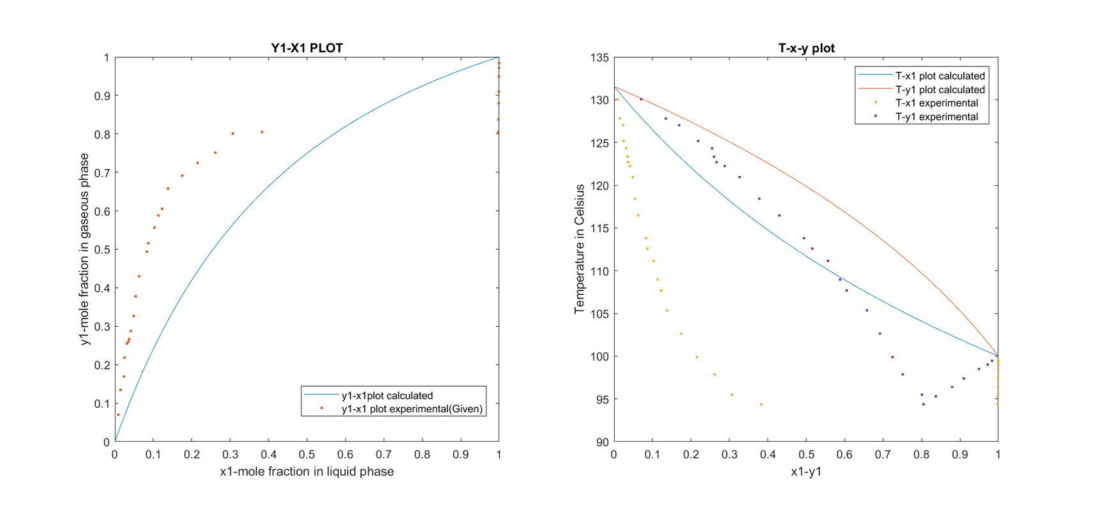
PROBLEM STATEMENT: Assuming an ideal system (i.e. Raoult’s law is directly valid, and there is no deviation from ideal behaviour), Plot y v/s x (Vapour-Liquid equilibrium) curve in MATLAB.
IDEAL RAOULT's LAW:
Py(i) =x(i)*P(i)sat
SYSTEM- Water and 4-Methyl 2-Pentanol

Slide 10
PROBLEM STATEMENT: For selected binary system, assume it as a real system (meaning that deviation from ideal behaviour is present in both liquid and vapour phase):
(i) Plot y v/s x (vapour liquid equilibrium) curve in MATLAB for the same, taking into consideration the activity and fugacity coefficient in Raoult’s Law (state all assumptions that you have taken).
SOLUTION
SYSTEM- Water and 4-Methyl 2-Pentanol
ACTIVITY COEFFICIENT MODEL(Assumptions)- Van Laar Model
lnϒ1=A12{(A21*x2)/(A12*x1+A21*x2)}2
lnϒ2=A21{(A12*x1)/(A12*x1+A21*x2)}2
where, A12=1.2935 and A21=5.8737
EQUATION of STATE to be followed- Van Der waal’s equation
MODIFIED RAOULT's LAW
P*y(i)*φ(i) =x(i)* ϒi*P(i)sat* φ(i)sat

Slide 11
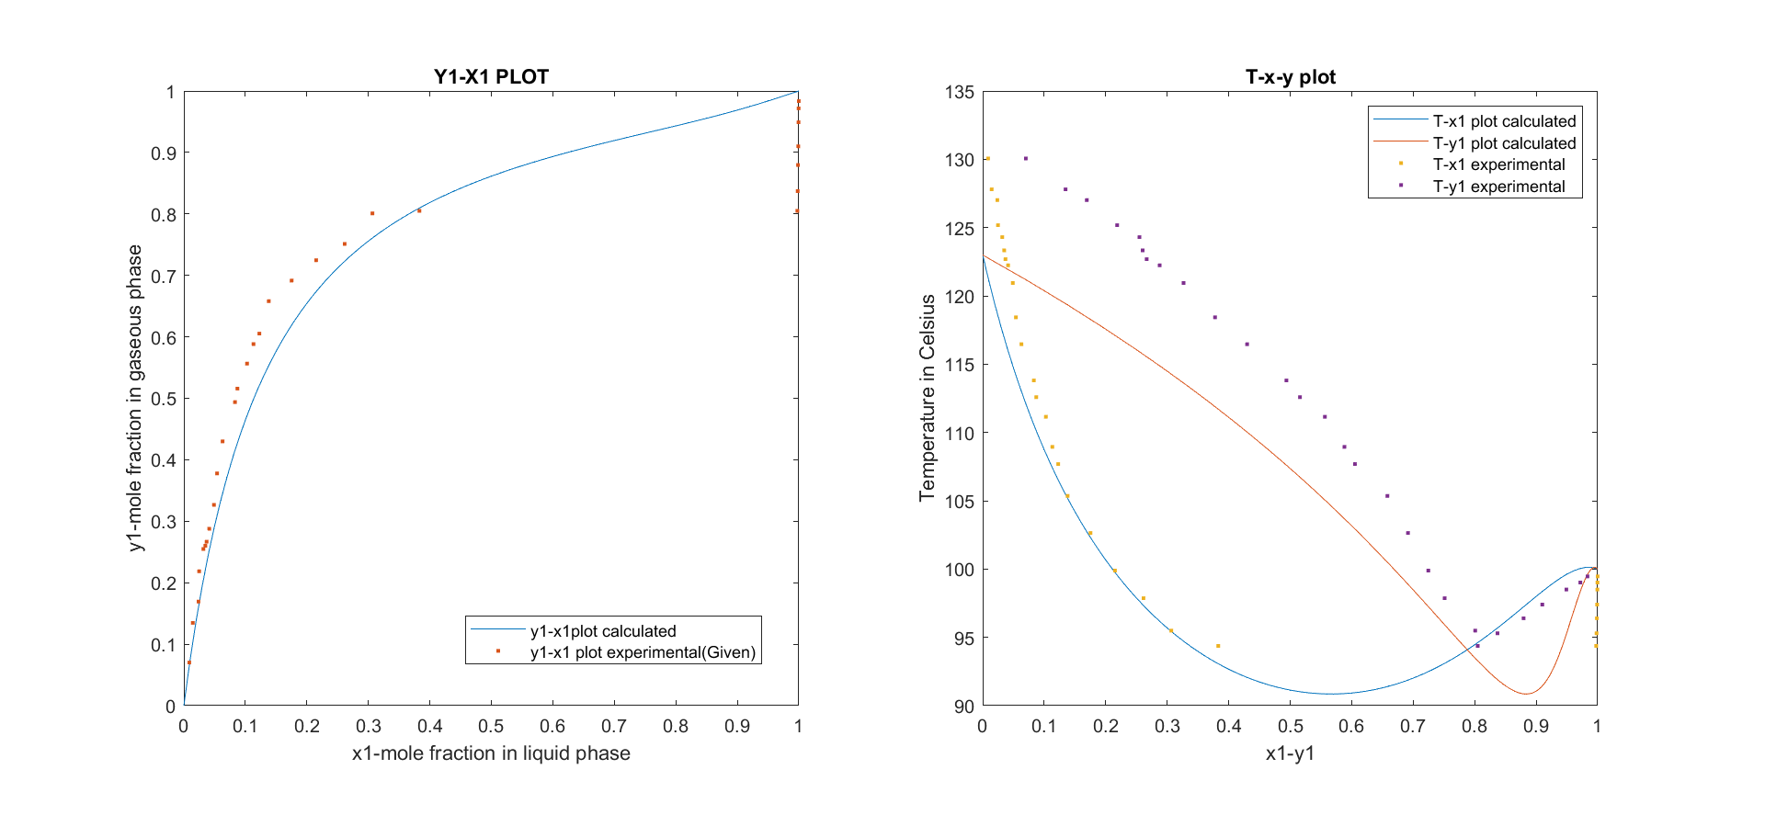
PLOTS

Slide 12
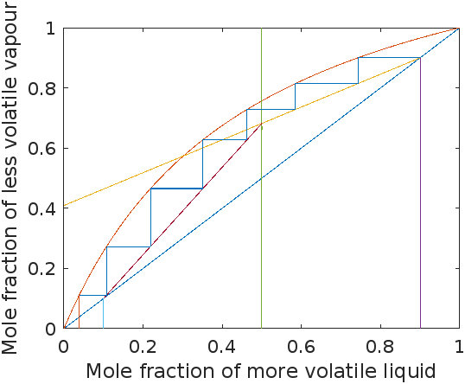
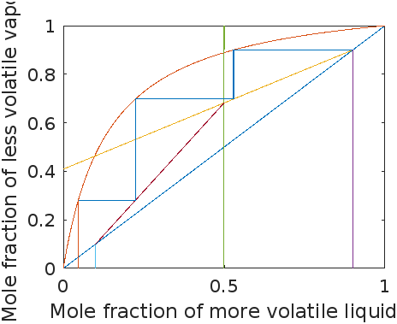
Mc Cabe Thiele method
PROBLEM STATEMENT: Assuming that the system is ideal (system following Raoult’s law) and Non-Ideal system. Compare the graphs, no. of trays obtained in both the cases for each sub-problems..
For Ideal
For real

Slide 13
EQUATIONS USED DURING FORMULATION via MATLAB
FEED LINE [q-line]
STRIPPING SECTION LINE
m=Feed/(Feed-1);
y = m*(x - x4) + y4;
x4,y4 is the value of feed
m1=(y6-y3)/(x6-x3);
y= m1*(x-x3)+y3;
y6,x6 are the intersection point
x3,y3 are the bottom product
RECTIFYING SECTION LINE
OUTCOMES
M=(Reflux_ratio/(Reflux_ratio+1));
y=M*(x-x5)+y5;
x5= Top_product;
y5= Top_product;
→ Where we should keep the feed ?
→ Actual & Minimum number of trays
→ Minimum Reflux ratio to operate the distillation column

Slide 14
THANK YOU
:)

